Slide 1


Slide 2

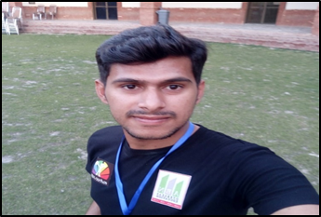
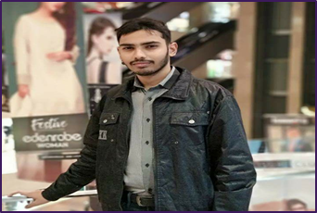


Group
Members:
Jahanzaib Maqsood
M Usama Ashraf
Imran Latif
Supervisor :Mr. Sajid Ibrahim Hashmi

Slide 3
GO Invest Me
A Crowdfunding Investment Platform for Startups
Final Year Project - Presentation

Slide 4


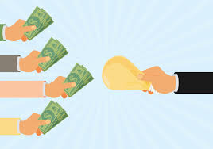

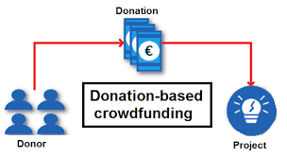
Crowdfunding
Collecting small number of amounts from many people to start business
Entrepreneurs raise funds from anyone for start up or to grow business
Investors invest their assets in business to gain maximum profit
Reward
Equity
Donation

Slide 5
Problem Statement
Incomplete Environment between Entrepreneur and Investor
Mostly platform focused on Reward and Donation based
No Platform specially for Pakistan
Tough time for Startup(Prototype)
No opportunity for Investor to Invest their assets

Slide 6

GoInvestMe
Business and communication channel between entrepreneur & Investor
Entrepreneur share their ideas and deal with investors.
Entrepreneur lease money from investor to start business
Implemented Equity Based Crowdfunding
Payment and return of Payment

Slide 7
Objectives
Provide a bridge for Entrepreneur and Investor to make businesses
To increase the business efficiency for community online not manual
Increasing business opportunities by reducing time cost
To make available the system at user’s place
Provide opportunity specially in Pakistan

Slide 8





Motivation & Scope
Entrepreneurship
Problems for Entrepreneurs
Solution as a online Platform
Develop a platform
User Friendly and Flexible
Secure

Slide 9

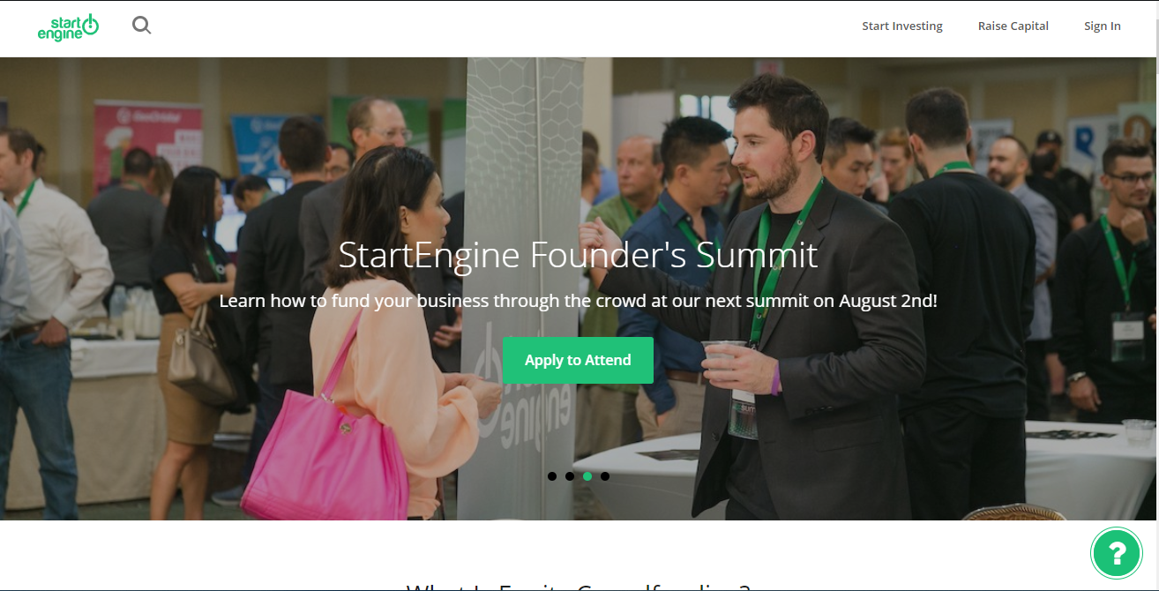
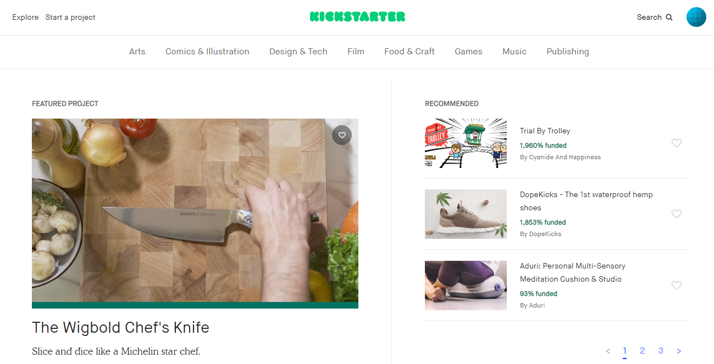
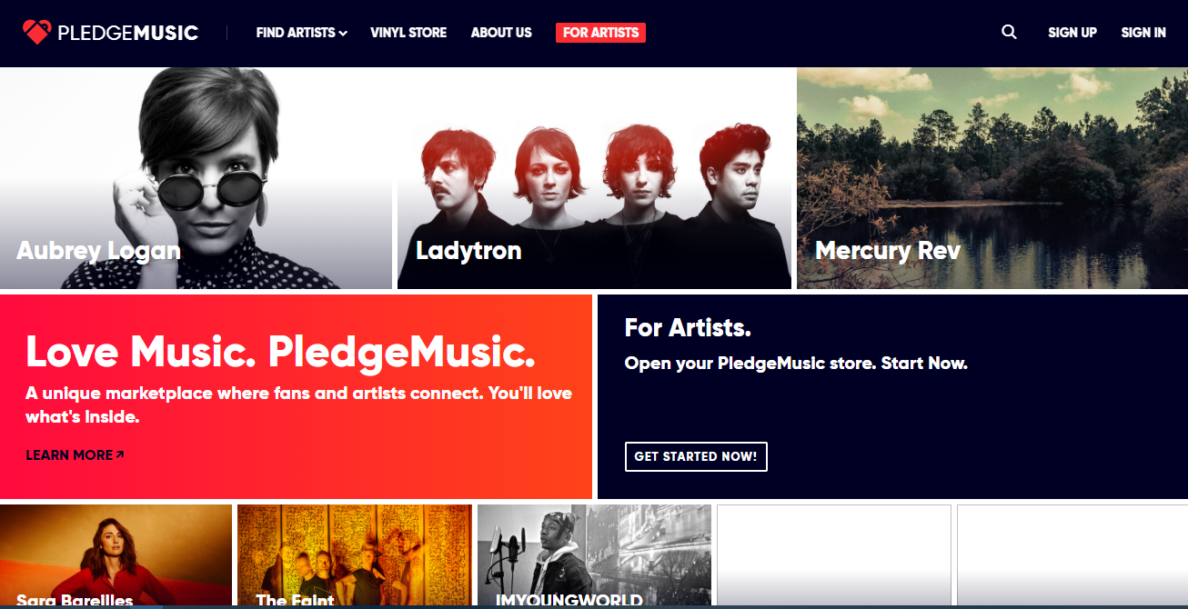
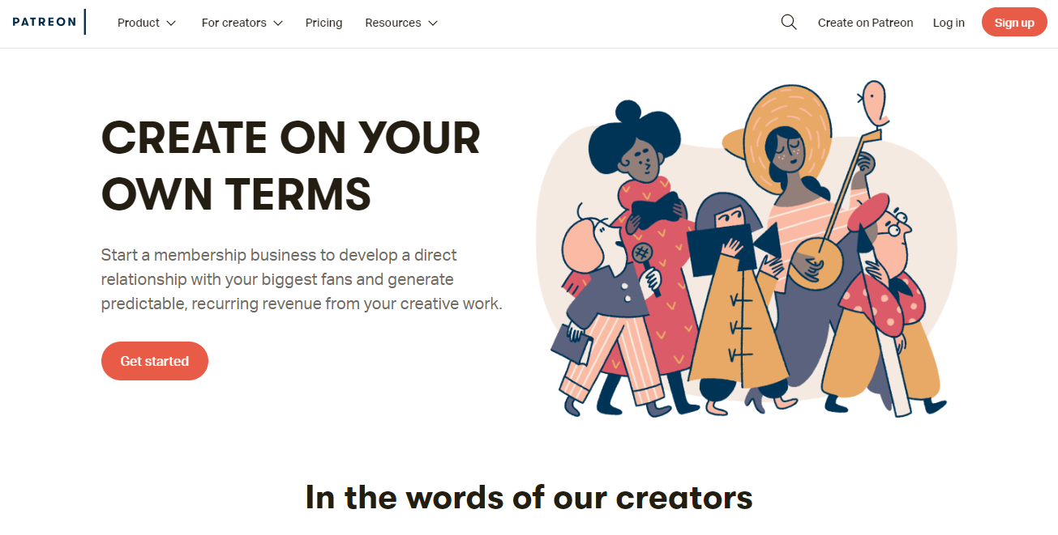
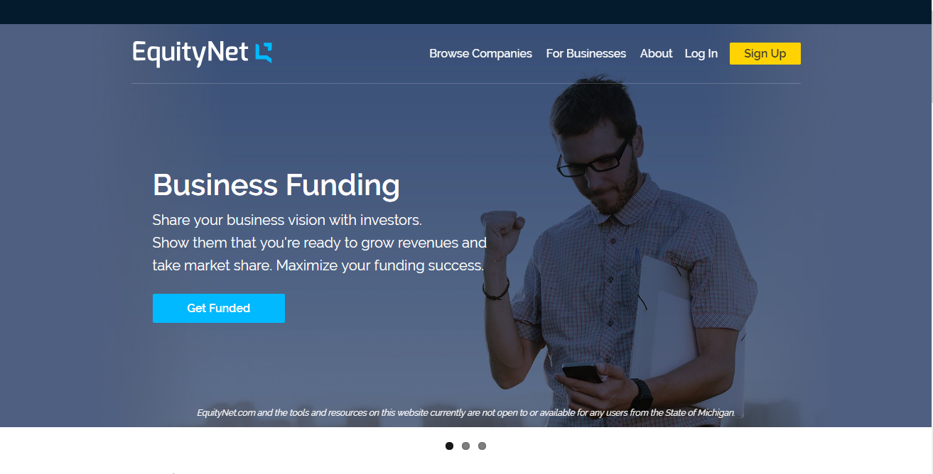




Related Work

Slide 10
Limitations
No user friendly
No proper Equity based
Mostly in Europe
Some focused on specific category
Commission/tax
Some focused on specific group

Slide 11
Main Modules
Log In & Sign up
Campaigns
Profile
Payments
Investments
Admin Panel and Reports

Slide 12




Languages and Technologies
React with Redux
ASP.NET Core
MS SQL server
HTML
CSS
Bootstrap
JavaScript

Slide 13

Architecture of our project
ReactJS +Redux
Request(GET,Post,Put)
Restful web API
ASP.NET CORE
Interface
JSON Response
Rest Request Handler
Service Handler
(Process request and prepare JSON response)
Database Handler
(Read and write database resources)
Entrepreneur
Investor

Slide 14
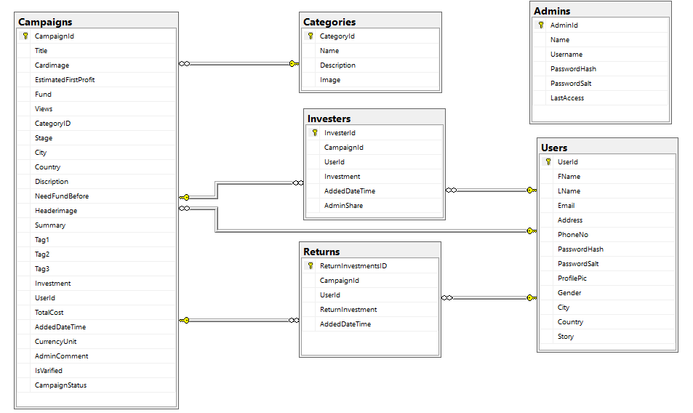
ERD Diagram

Slide 15
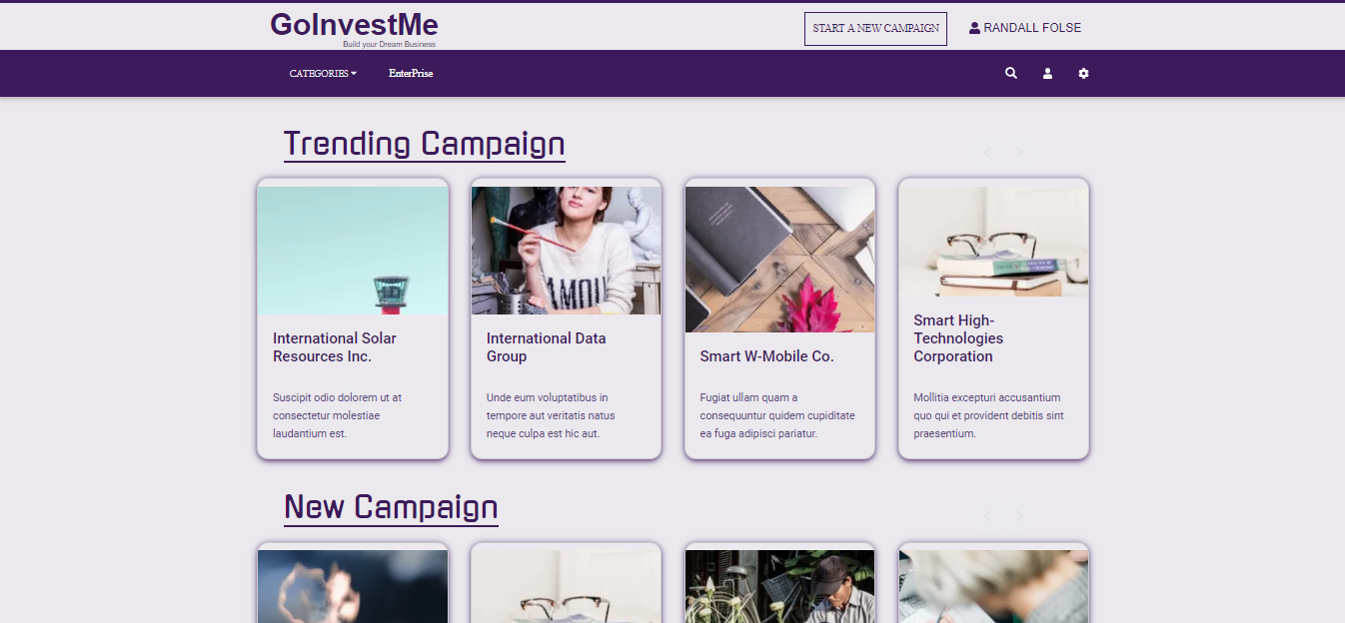
Screenshots

Slide 16
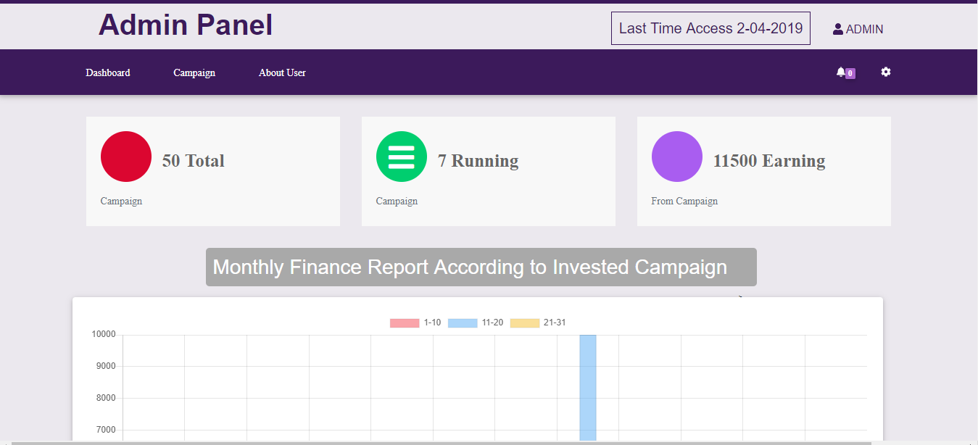
Screenshots

Slide 17
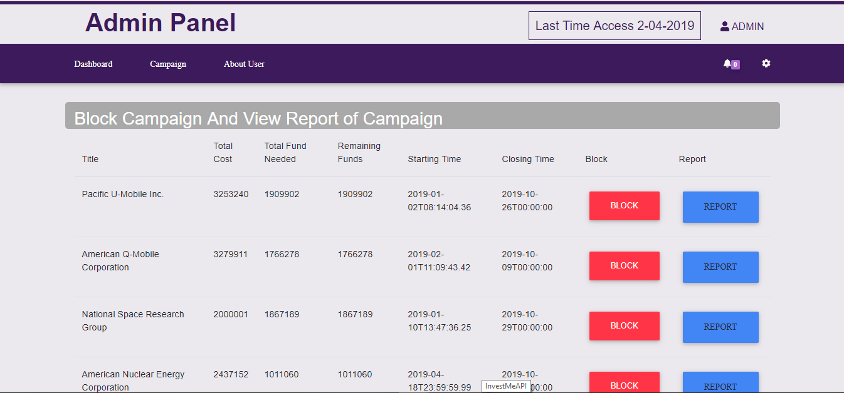
Screenshots

Slide 18
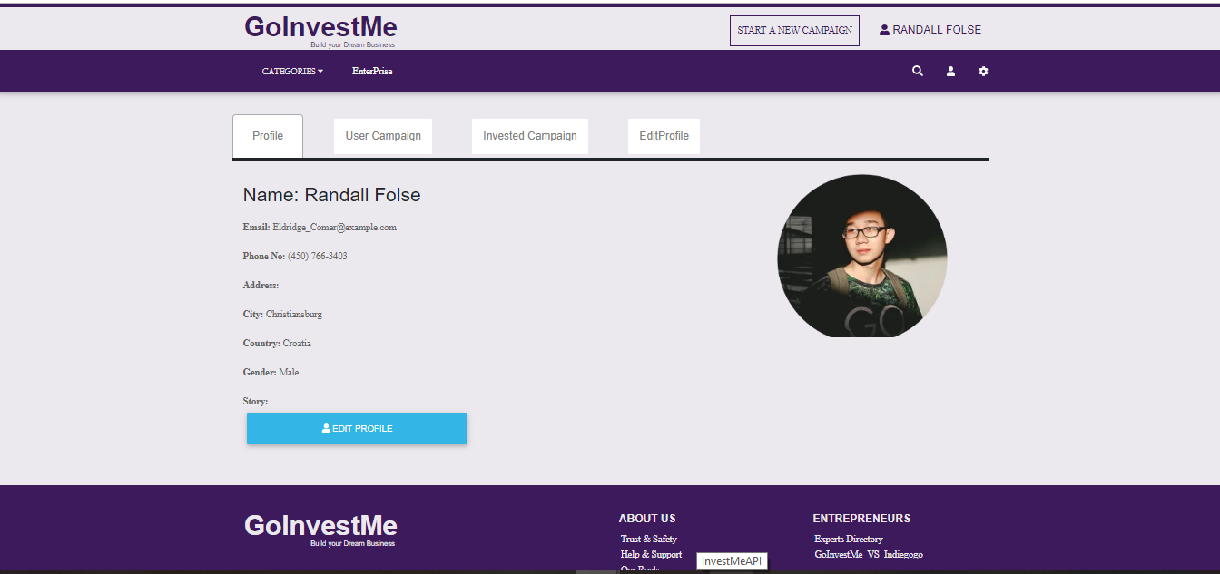
Screenshots

Slide 19
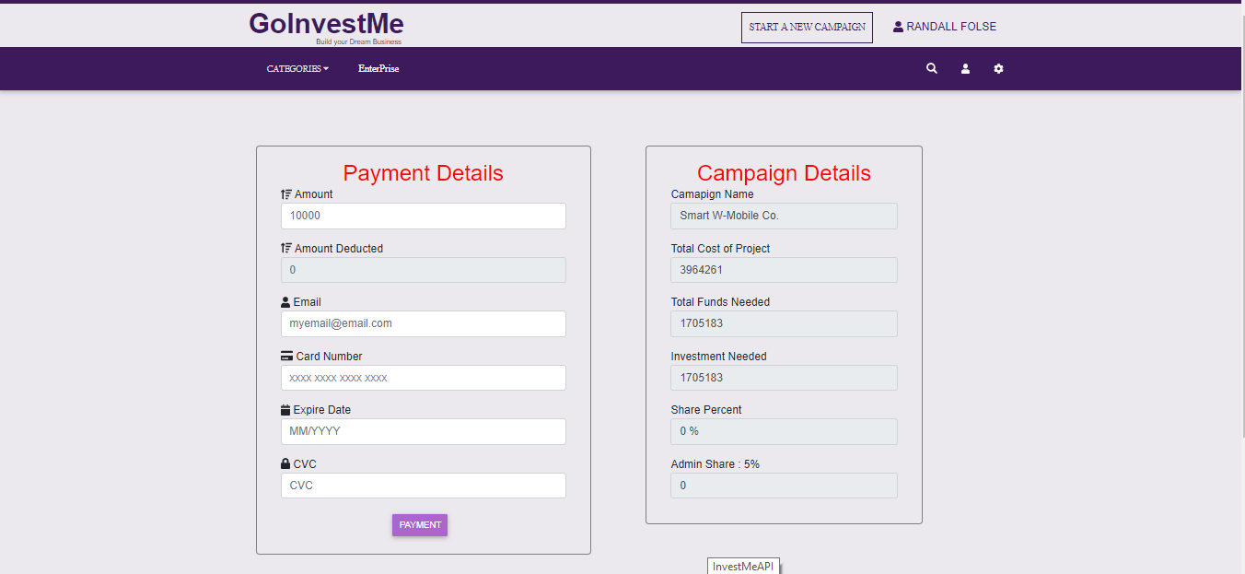
Screenshots

Slide 20
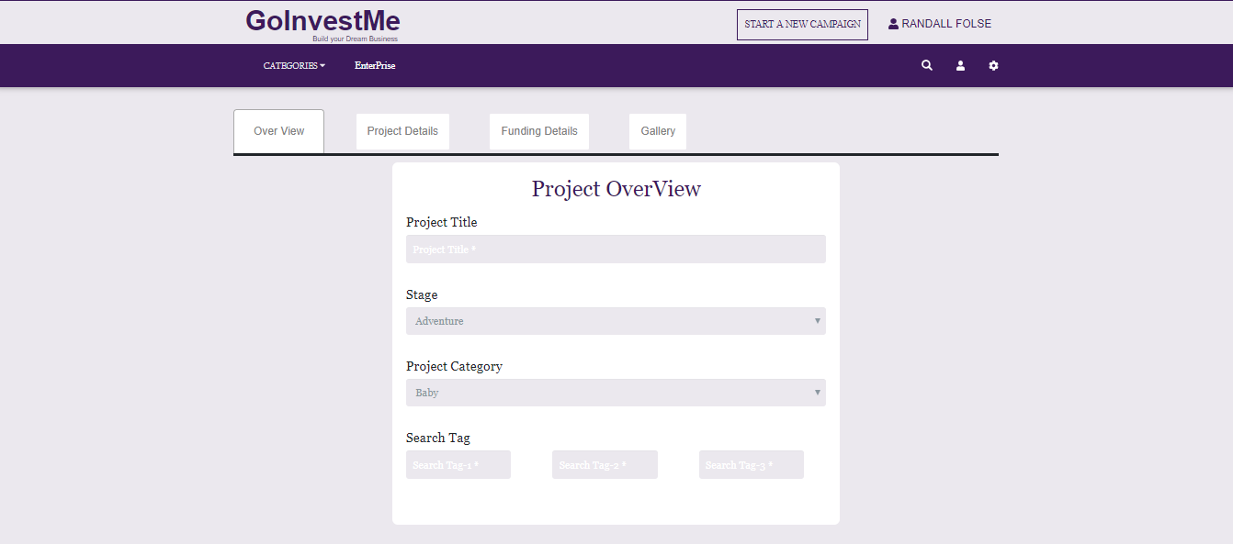
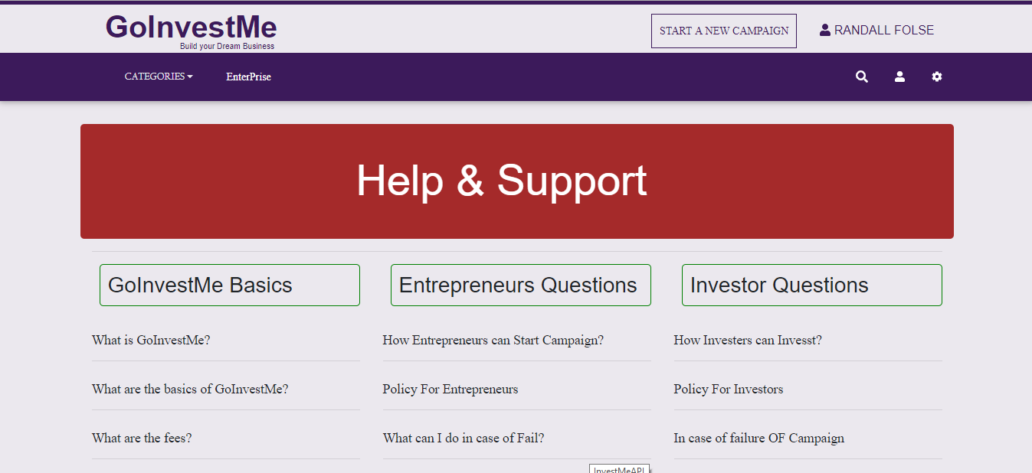
Screenshots

Slide 21
Conclusion
Provide certainty & belief
Comfort to both Entrepreneur and Investor
Knowledge of new technologies and ideas
Opportunity to increase assets

Slide 22
Future Work
More functions to facilitate companies
Donations and reward based
User Friendly Chat room
Android and IOS Application
Proper payroll system

Slide 23
References
Brewer and Anthony, “Richard Cantillon: Pioneer of Economic Theory. Routledge,” 1992
W. S. Jevons, “Richard Cantillon and the Nationality of Political Economy,” 1881
R. Afschar, “Entry regulation and entrepreneurship: a natural experiment in German craftsmanship,” 2013
KickStarter,” [Online]. Available: www.KickStarter.com
B. Feldman, “Why would a company choose to use an SQL server Over open-source databases,” 27 October 2014. [Online].

Slide 24


